Slide 1
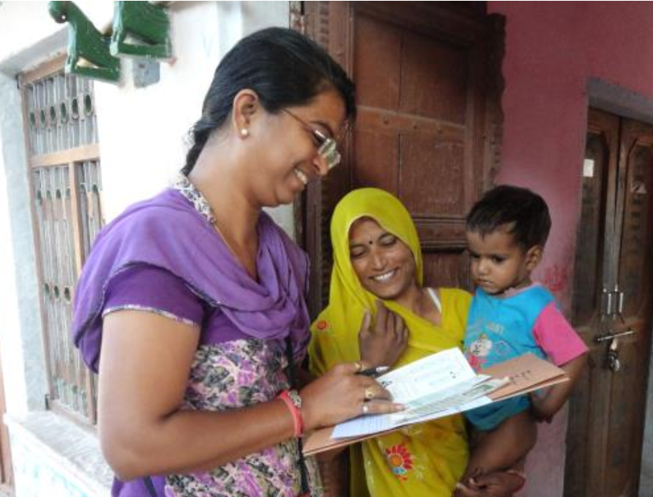
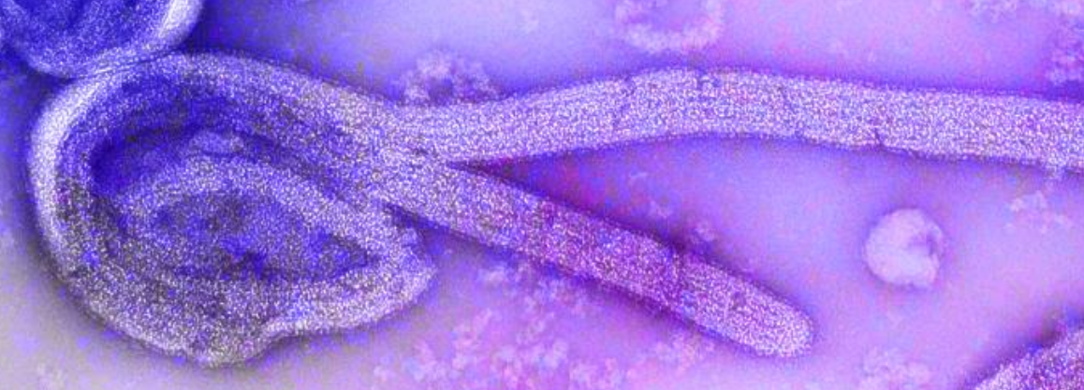
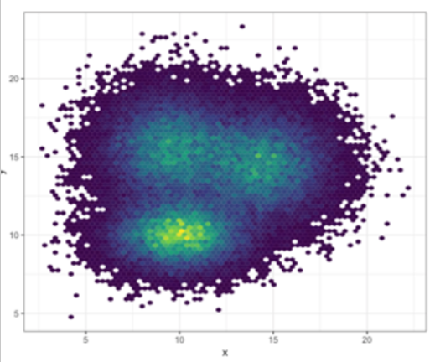

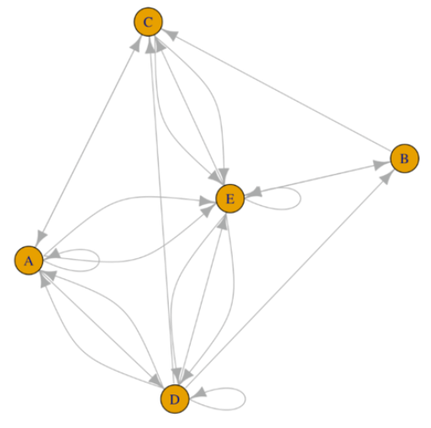
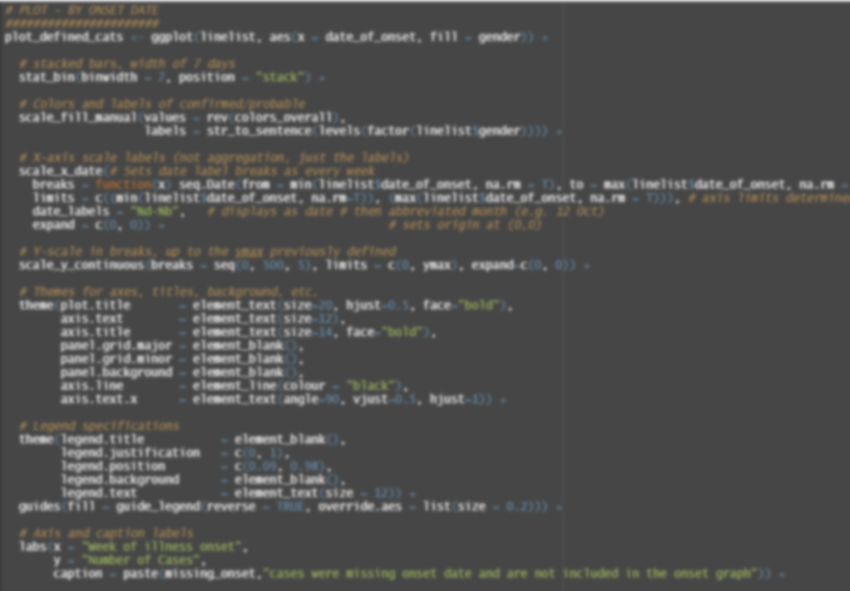
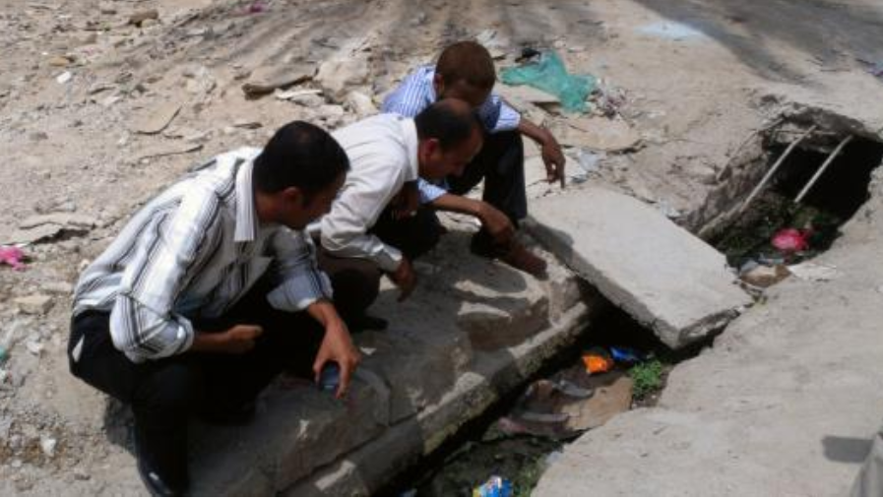
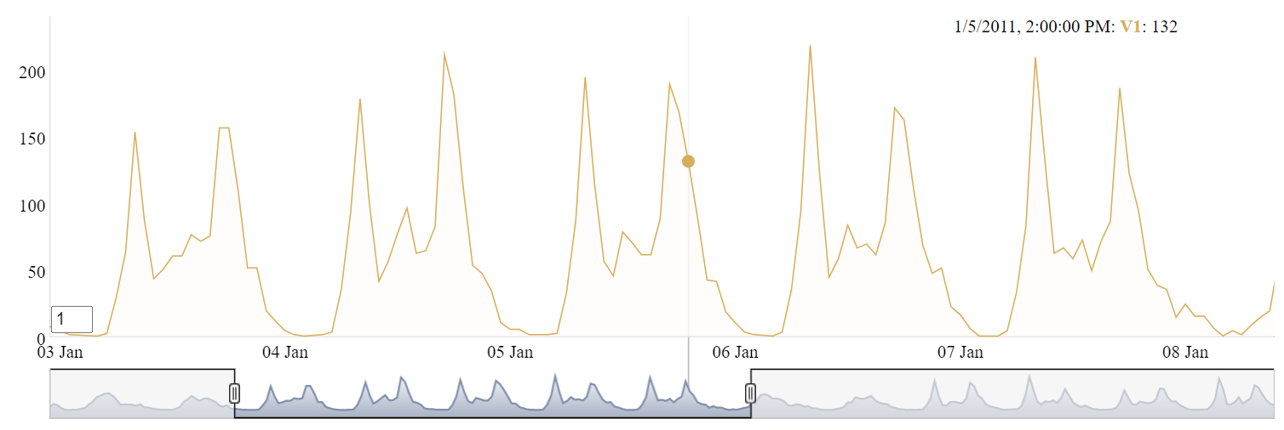
R Handbook for
Epidemiologists

Slide 2
Sources:
2013 Yemen looking for mosquito breeding sites: https://phil.cdc.gov/Details.aspx?pid=19623
Ebola virus: https://phil.cdc.gov/Details.aspx?pid=23186
Survey in Rajasthan: https://phil.cdc.gov/Details.aspx?pid=19838
Network: https://www.r-graph-gallery.com/257-input-formats-for-network-charts.html

